Slide 1
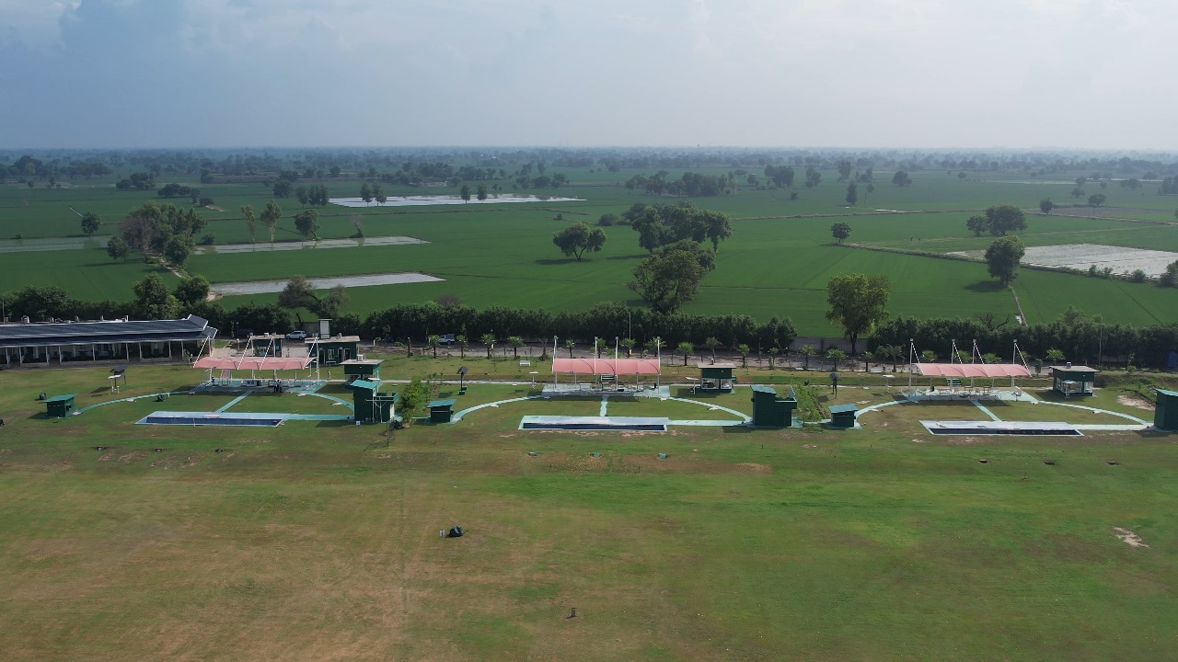
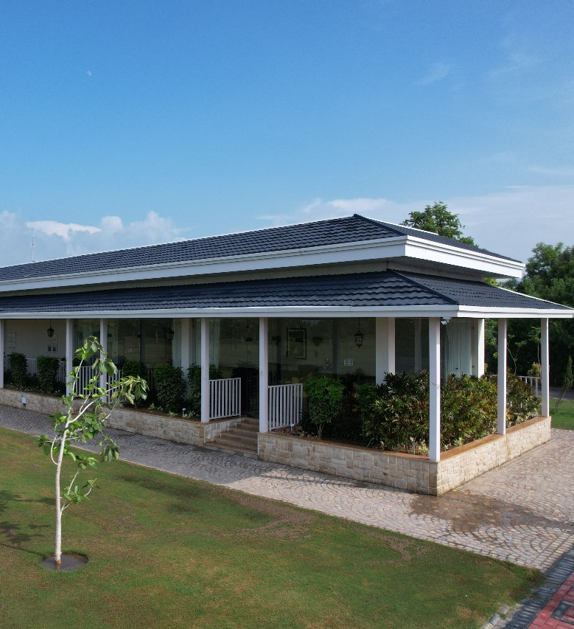
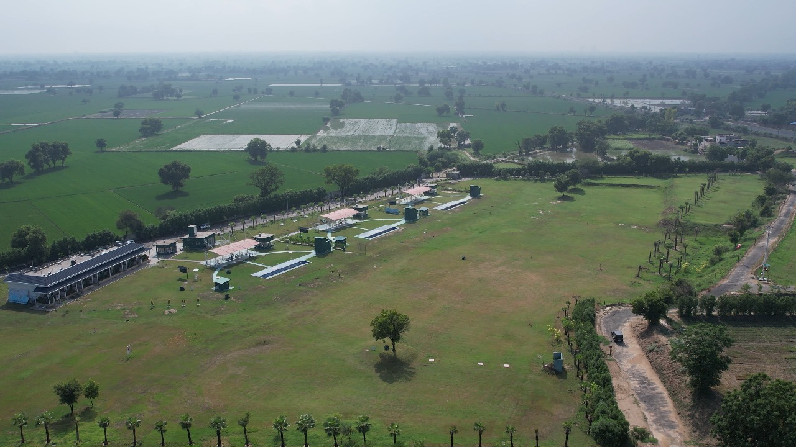
Bhai Devinder Singh Sidhu Gun Club
Bhucho, Bathinda.

Slide 2
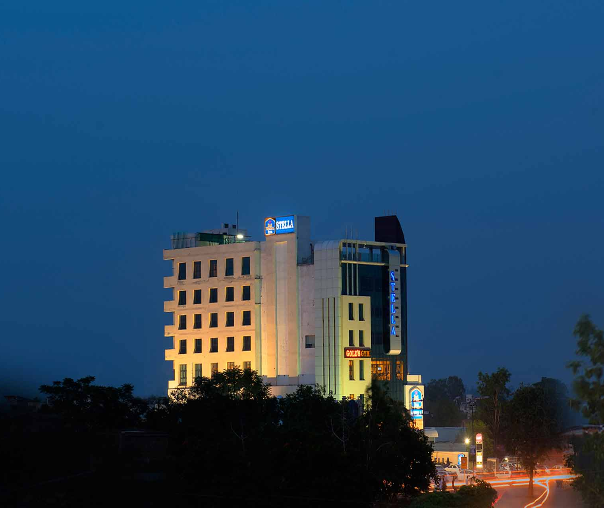
Price: 3579
Rating: 4
Price: 3579
Rating: 4
DISTANCE FROM RANGE: 15KM
BUS STAND: 4 km
Railway Station: 2.6km
Airport: 22km
Contact: 87250-33006
HOTEL STELLA

Slide 3
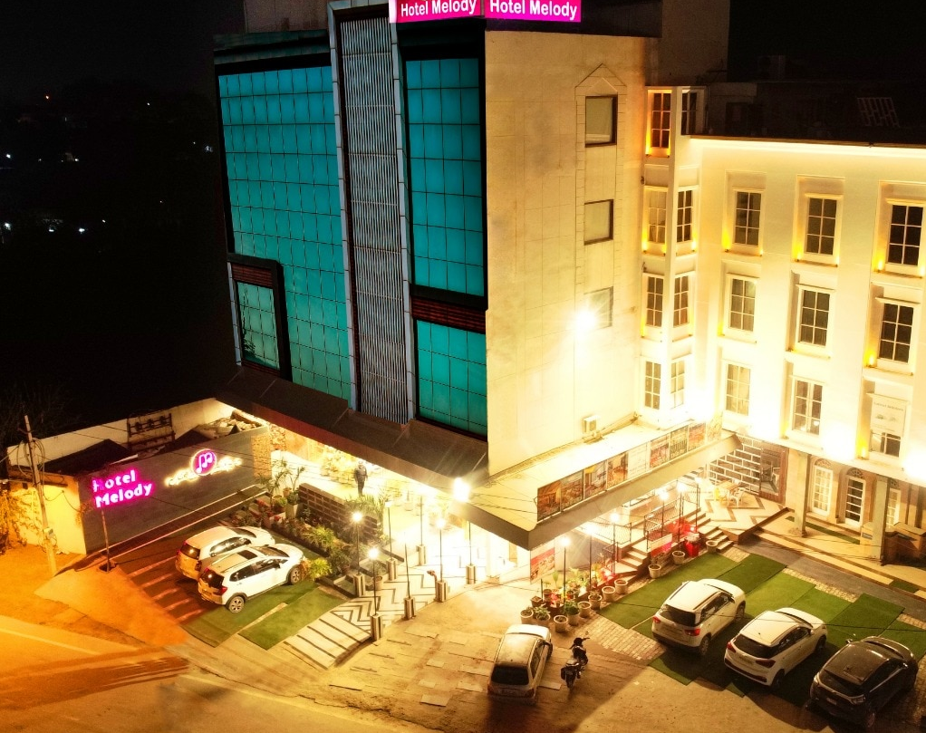
HOTEL MELODY
PRICE: 3579
RATING: 4
DISTANCE FROM RANGE: 15KM
BUS STAND: 3 km
Railway Station: 2 km
Airport: 20.7km
Contact: 98888-87077

Slide 4
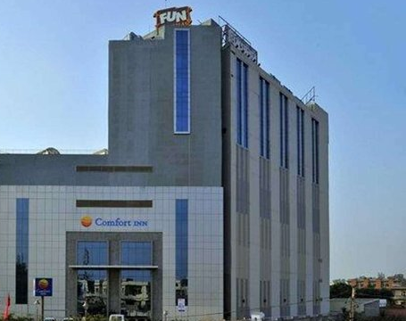
COMFORT INN TULIP HEIGHTS
PRICE: 4098
RATING: 4
DISTANCE FROM RANGE: 15KM
BUS STAND: 3 km
Railway Station: 2 km
Airport: 20 km
Contact: 75270-32501

Slide 5

BAHIA RESORTS
PRICE: 3000
RATING: 3
DISTANCE FROM RANGE: 2KM
BUS STAND: 12.6km
Railway Station: 13.6km
Airport: 35.7km
Contact: 98888-87077

Slide 6

SAPPHIRE
PRICE: 3168
RATING: 3
DISTANCE FROM RANGE:13KM
BUS STAND: 2.9km
Railway Station: 2.7km
Airport: 24.7km
Contact: 87250-22776

Slide 7
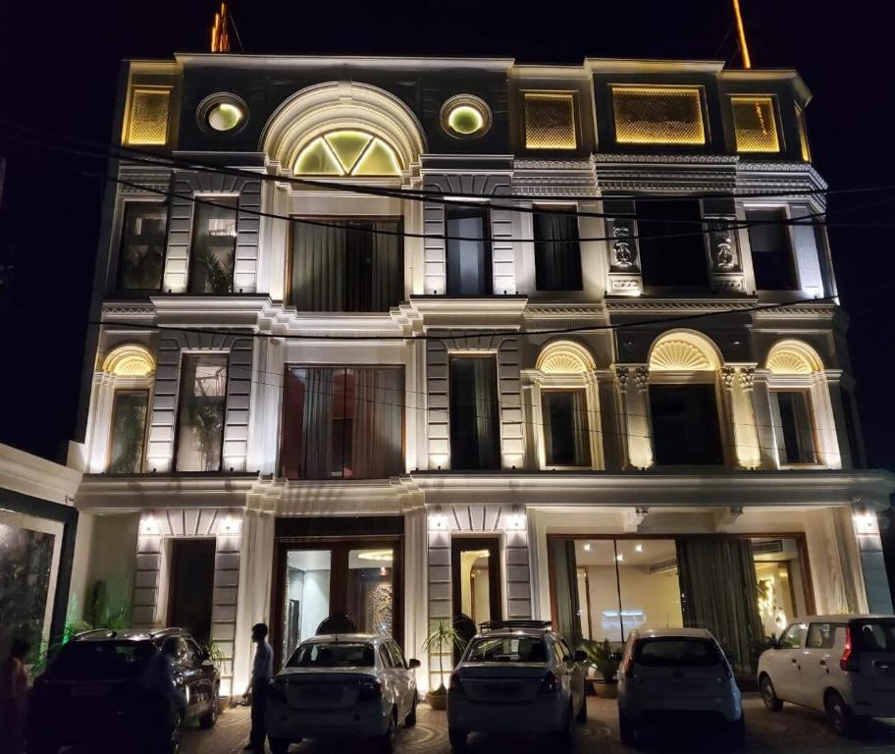
THE SIGNET ROYALE
PRICE: 3360
RATING: 3
DISTANCE FROM RANGE:13KM
BUS STAND: 2.8km
Railway Station: 2.6km
Airport: 24.6km
Contact: 91683-55000

Slide 8

PRICE: 4399
RATING: 3
DISTANCE FROM RANGE:13KM
BUSTAND: 2.6km
Railway Station:1.7km
Airport: 24.3km
Contact: 93560-60512
SEPAL

Slide 9
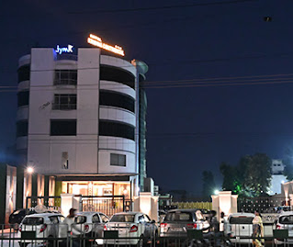
PRICE: 3134
RATING: 3
DISTANCE FROM RANGE:13KM
BUS STAND: 1.5km
Railway Station: 2km
Airport: 26.2km
Contact: 0164-2216902
KRISHNA CONTINENTAL

Slide 10
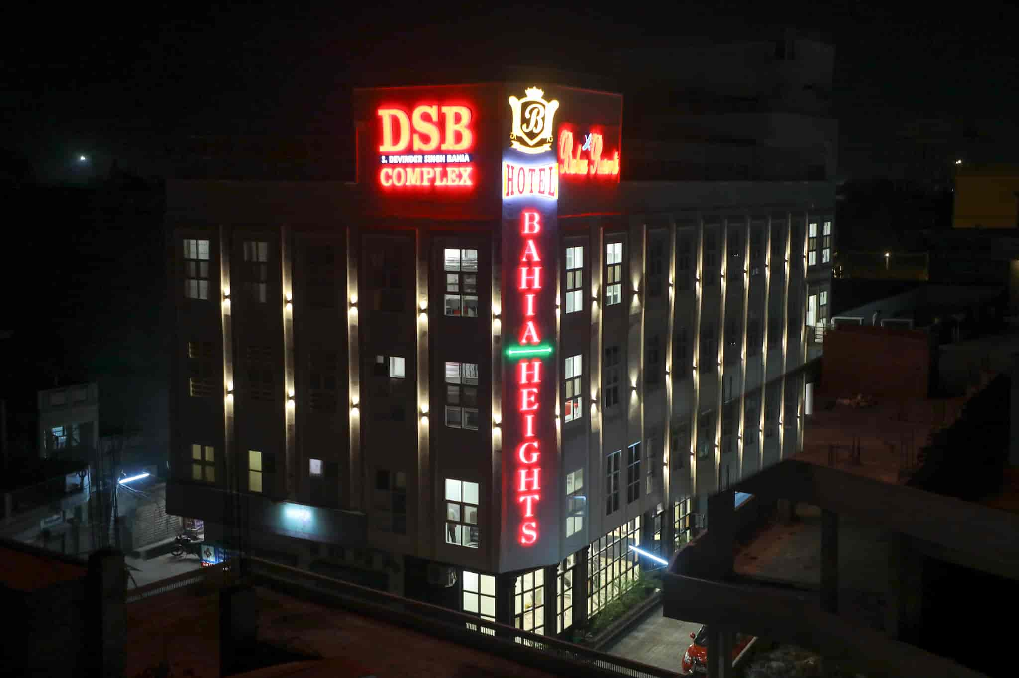
PRICE: 2297
RATING: 3
DISTANCE FROM RANGE:13KM
BUSTAND: 1km
Railway Station: 1km
Airport: 26km
Contact: 0164- 5000877
BAHIA HEIGHTS

Slide 11
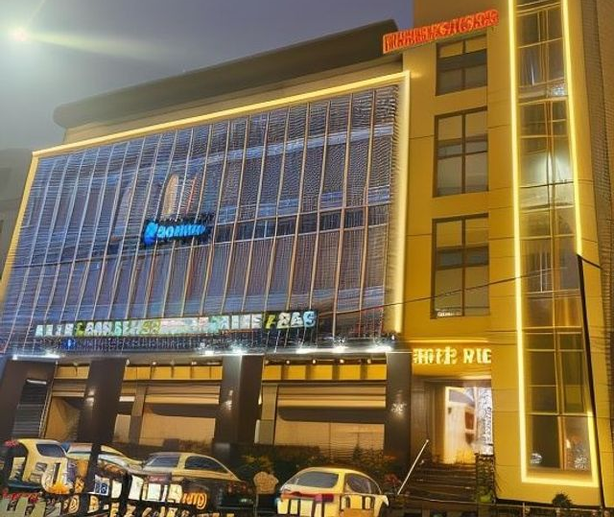
PRICE: 1500
RATING: 3
DISTANCE FROM RANGE:13KM
BUSTAND: 800 Meter
Railway Station: 1km
Airport: 26km
Contact: 84375- 30450
VRC

Slide 12


